Slide 1
Difference-in-Difference
Prof. Sebastián Vallejo Vera

Slide 2
One of the main problems of causal inference is identification.
We often have limitations on how much we can argue that our treatment was assigned randomly (in observational data, we rarely can).

Slide 3
The difference-in-differences method takes advantage of situations where individuals, cities, states, provinces or any other units are “haphazardly” assigned to different states of the world or conditions.
The difference-in-differences method exploits the idea that treatment and control outcomes move in parallel in the absence of treatment.
When they do, the divergence of a post-treatment path from the trend established by a comparison group may signal a treatment effect.

Slide 4
Under what conditions can we apply a difference-in-difference approach?
We need a group that has received the treatment, and a group the has not.
We need to observe both groups before and after the treatment.
We need to observe each group various times (for the parallel trends assumption).

Slide 5
D-i-D: The Basics

Slide 6

Event/
Intervention
== Treatment
¿Treatment Effect?
Before Treatment
After Treatment

Slide 7

Event/
Intervention
== Treatment
Counterfactual
Before Treatment
After Treatment

Slide 8
Event/
Intervention
== Treatment
Counterfactual
Before Treatment
After Treatment

Slide 9


Event/
Intervention
== Treatment
Treatment Effect!
Observed Effect
Effect of Time
Before Treatment
After Treatment

Slide 10
Treatment Effect = Observed Effect – Effect of Time
We have a problem here, though…
That’s right, we can only estimate the Effect of Time if we can observe the counterfactual. But we cannot observe the counterfactual.
So how can we figure out how much of the observed effect is a product of time, and how much is a product of the treatment?

Slide 11
Event/
Intervention
== Treatment
Counterfactual
Treatment Effect = Observed Effect – Effect of Time
Before Treatment
After Treatment

Slide 13
Example: Kessler and Roth (2014)
Organ donation schemes have three options: opt-out, opt-in (e.g., United States), and active-choice (e.g., California).
There are more people that require organs than available organs.
Expert in the U.S. have pressured for years to change the organ donation scheme to one of active-choice.
In 2011, California changed its scheme from opt-in to active-choice. Kessler and Roth (2014) wanted to analyze what is the effect of changing the donation scheme in the actual donation of organs.

Slide 14
Kessler and Roth (2014) opted (get it) for a difference-in-difference design. What did they compare?
Yes! They compared California to the rest of the U.S. before and after the changes in the donation scheme in California.

Slide 15
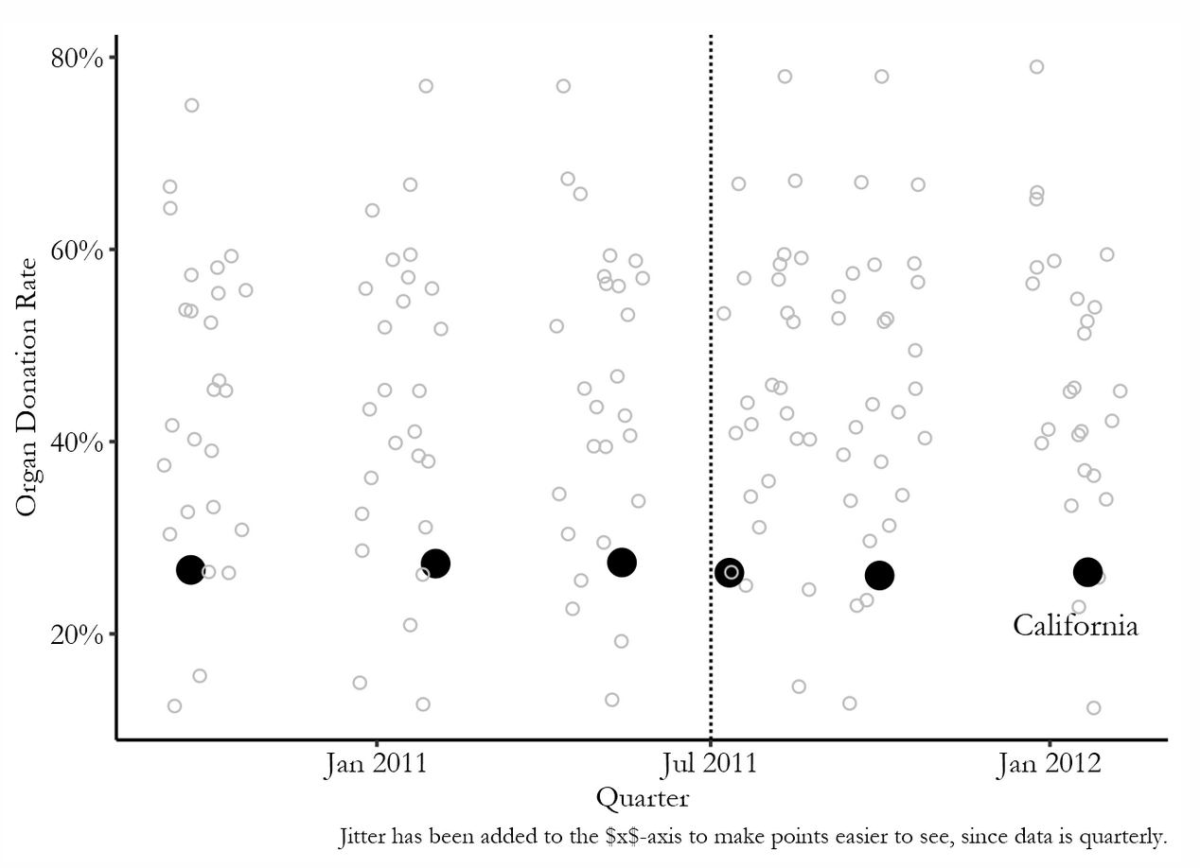

Slide 16
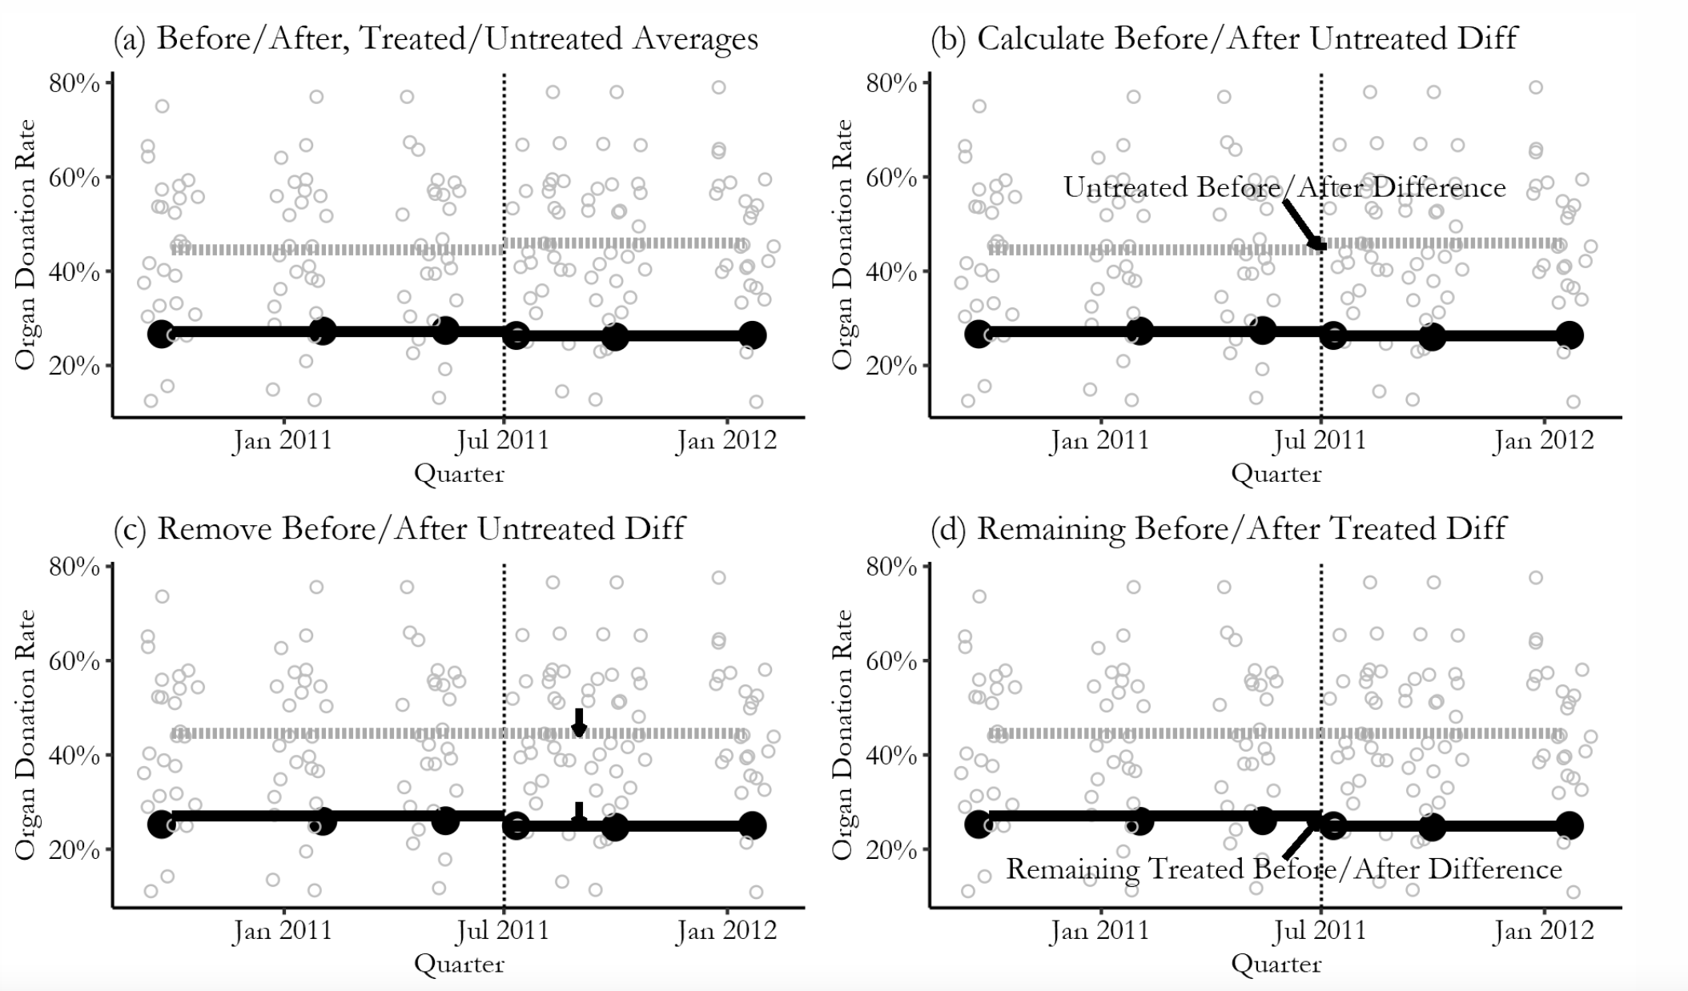
From 44.5% to 45.9% = 1.4
From 27.1% to 26.3% = -0.8
The effect is (-0.8) – (1.4) = -2.2 ☹

Slide 17
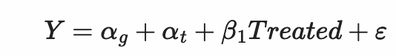
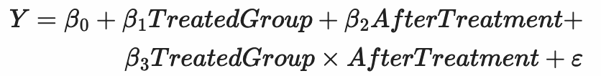

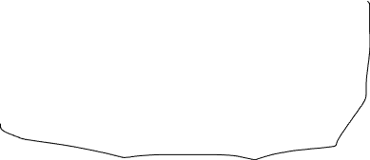




What about the Math (said no one ever)?
Dummy variable
This is the equation we want to estimate:
We can also estimate it this way:
Treatment Effect
Group fixed effect
Time fixed effects (before and after)

Slide 18
Event/
Intervention
== Treatment
Before Treatment
After Treatment

Slide 19
This multistate analysis uses a data set with 6 quarters and 51 states (including the District of Columbia), for a total of 162 observations. This data structure is called a state-quarter panel.
The state effects (g) in the equation control for fixed differences between states (for example, organ donations are less frequent, on average, in poorer states).
The quarter (t) effects in this equation control for trends in donation rates that are common to all states.
Finally, the equation attributes changes in donation within states to changes in Treated, a causal attribution that relies on a parallel assumption.

Slide 20
Go to code for 12 Difference in Difference.R / Vignette 11.1: Difference in Difference Example

Slide 21
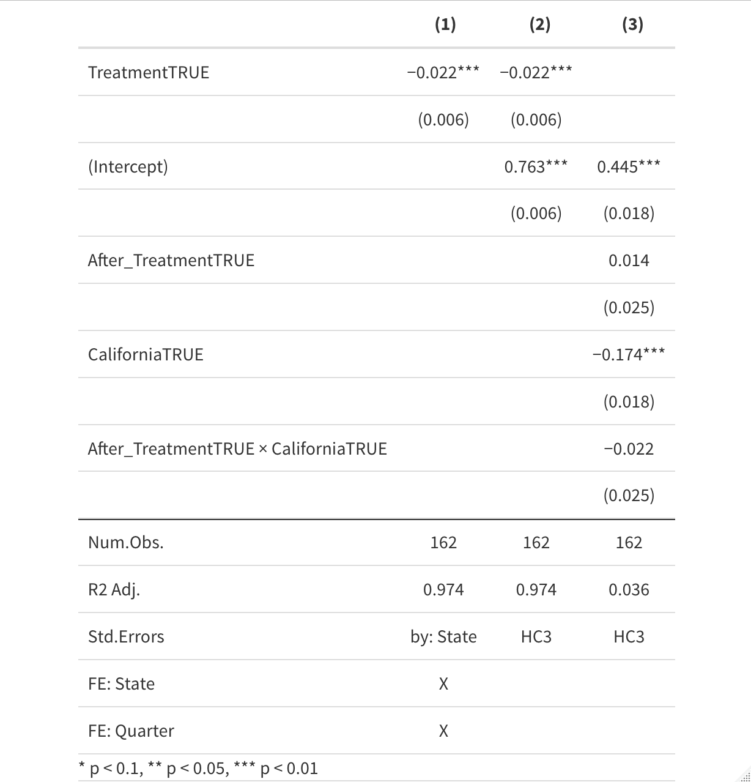

Slide 22
The Diff-in-Diff tool amounts to a comparison of slopes or trends across states.
The dotted line is the counterfactual outcome that lies at the heart of the DD research design: this line tells us what would have happened in California had everything evolved as it did in the U.S.
The fact that the solid line for California declines while the counterfactual increases is evidence for the ineffectiveness of the organ donot policy.
The 2.2% less organ donations uncovered by the Diff-in-Diff calculation is the difference between what really happened (observed effect) and what would have happened (counterfactual/effect of time) had organ donation in California and the U.S. unfolded in parallel.

Slide 23
The Diff-in-Diff counterfactual comes from a strong but easily stated assumption: common trends.
In Kessler and Roth (2014), Diff-in-Diff presumes that—absent any policy differences—the U.S. trend is what we should have expected to see in California.
Although strong, the common trends assumption seems like a reasonable starting point, one that takes account of pre-treatment differences in levels. With enough data, the assumption can also be probed, tested, and relaxed.

Slide 24
Models with state-specific linear trends provide an important check on the causal interpretation of any set of regression Diff-in-Diff estimates using multi-period data.
In practice, however, empirical reality may be considerably mushier and harder to interpret because the findings generated by a regression model like in the equation are often imprecise.
The sharper the deviation from trend induced by a causal effect, the more likely we are to be able to uncover it. On the other hand, if treatment effects emerge only gradually, estimates may fail to distinguish treatment effects from differential trends, with the end result being an imprecise and therefore inconclusive set of findings.

Slide 25
Parallel Trends Assumption

Slide 26
Event /
Intervention
== Treatment
Before Treatment
After Treatment

Slide 27
Event /
Intervention
== Treatment
Before Treatment
After Treatment
Effect though no parallel trends

Slide 28
Event /
Intervention
== Treatment (D)
Before Treatment
After Treatment
Spurious effect and no parallel trends

Slide 29
This is what we are looking for:
The effect of the treatment is the difference between before and after the treatment: treatment_effect + other_effects_treated_group.
The difference in the control group before and after the treatment: other_effects_control_group.
The difference-in-difference subtracts one from the other: treatment_effect + other_effects_treated_group - other_effects_control_group.
To estimate the treatment_effect, we need that other_effects_treated_group = other_effects_control_group. This is the parallel trend assumption.

Slide 30
How to choose a good control group?
There will be signs:
There is no particular reason why the control group will change when the treatment occurs.
The control group and the treated group are, in general terms, similar
Both groups had similar trajectories in their dependent variable before the treatment.

Slide 31
¡Ey Yo! Good control group *CHECK*

Slide 32
¡There is none! We can never know because these are not observable.
HOWEVER…

Slide 33
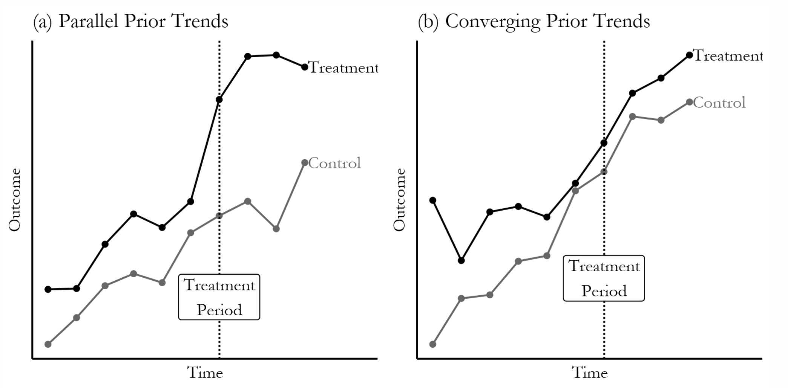

Slide 34

PLACEBOS

